Slide 1
Little Library Project
Worship at Work
Sunday, May 29th
Wear Your Work Clothes!

Slide 2
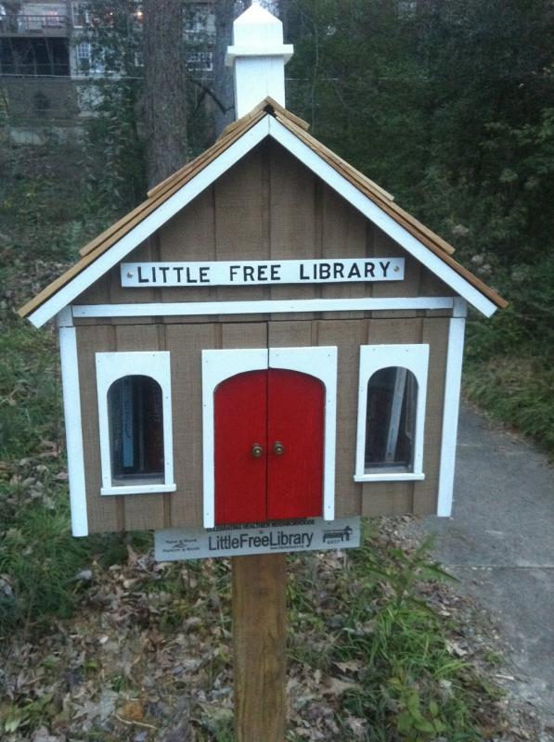
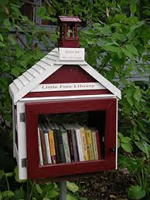
Little Library Project
Borrow/Return/Donate a Book

Slide 3
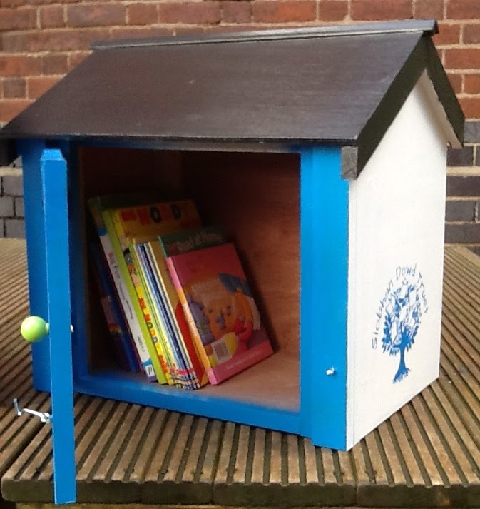
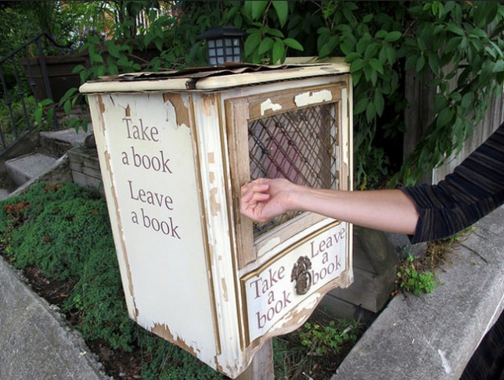
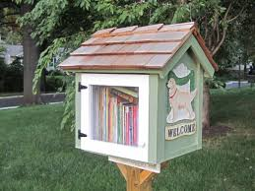
Little Library Project
Borrow/Return/Donate a Book

Slide 4
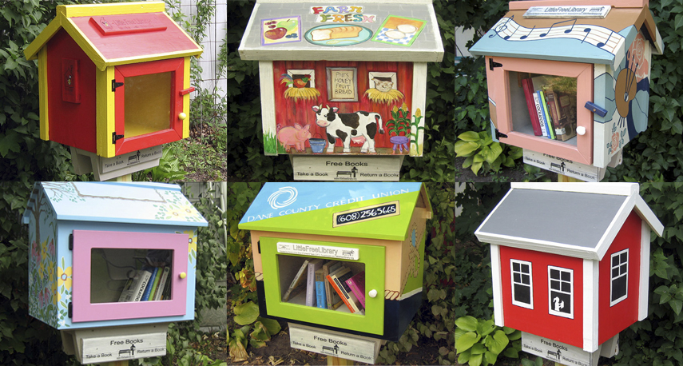
Little Library Project
Borrow/Return/Donate a Book

Slide 5
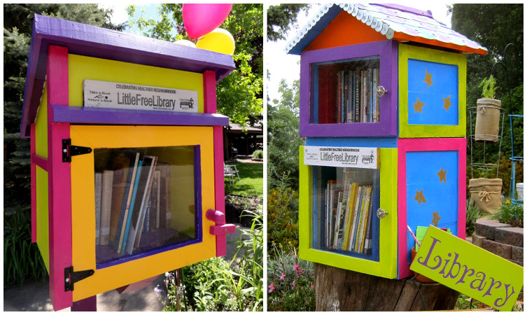
Little Library Project
Borrow/Return/Donate a Book

Slide 6
Little Library Project
Worship at Work
Sunday, May 29th
Wear Your Work Clothes!

